Slide 1
INFLUENZA VIRUS
Family: Orthomyxoviridae

Slide 2
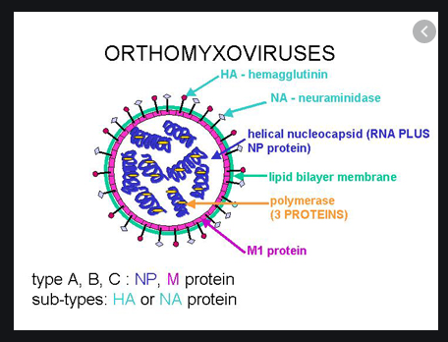
Orthomyxovirus
ORTHO- FREE
MYXA- MUCUS
Spherical

Slide 3
Enveloped
Single stranded segmented RNA
They have affinity for mucin- mucin are a family of high molecular weight, heavily glycosylated proteins (glycoconjugates)
They adsorb on to mucoprotein receptors on erythrocytes, causing haemagglutination
jj

Slide 4
INFLUENZA VIRUS
Influenza virus type A
Influenza virus type B
Influenza virus type C

Slide 5
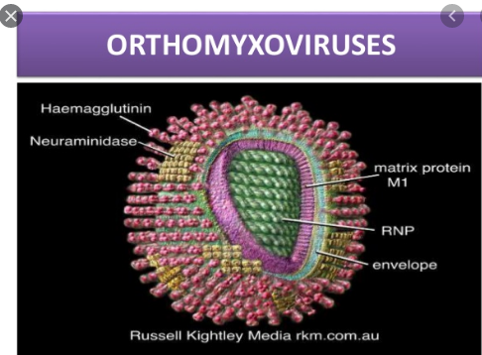
Morphology
Spherical particle
Helical symmetry
RNA genome
Envelop
Peplomer

Slide 6
Spherical particle
Spherical
Diameter: 80- 120 nm

Slide 7
Helical symmetry
The nucleocapsid has a helical symmetry

Slide 8
RNA genome
Single stranded, segmented RNA genome
Exists as 8 pieces

Slide 9
Envelope
The nucleocapsid is enclosed by an inner protein layer called the matrix or M protein and outer lipid layer
Protein part is virus coded
Lipid part is derived from the host cell membrane during the process of replication by budding

Slide 10
Peplomer
2 types: Haemagglutinin
Neuraminidase
Haemagglutinin is triangular in cross section -Neuraminidase spikes are mushroom shaped

Slide 11
Antigenic structures
Nucleoprotein- RNA
Matrix protein
Haemagglutinin: when influenza virus is mixed with erythrocytes, the virus is adsorbed on to the mucoprotein receptors on the surface of the erythrocytes by Haemagglutinin spikes thus resulting in hemagglutination.
Neuraminidase: it acts on the red cell receptors, destroying it by splitting N acetylneuraminic acid

Slide 12
Antigenic variation
Influenza virus undergo antigenic variations- antigenic drift & antigenic shift
Antigenic drift is the minor antigenic changes in either haemagglutinin or neuraminidase or both.
It is a gradual sequential change occurring regularly at frequent intervals.
It occurs as a result of mutation in HA & NA genes

Slide 13
Antigenic shift
Major antigenic change
It results in emergence of new subtype unrelated to original strain
It is abrupt, drastic and discontinuous
Change occurs in HA, NA, or both
The change results from recombination
Antibodies to the predecessor virus cannot neutralize the new variant

Slide 14
Resistance
Inactivated by heat and formaldehyde

Slide 15
Cultivation
Animal inoculation: in mice by intranasal inoculation
Egg inoculation: it is cultivated in the amniotic cavity of 11-13 days old chick embryo. Virus is detected by hemagglutination test performed with the amniotic fluid.
Tissue culture: it can be isolated on monkey kidney

Slide 16
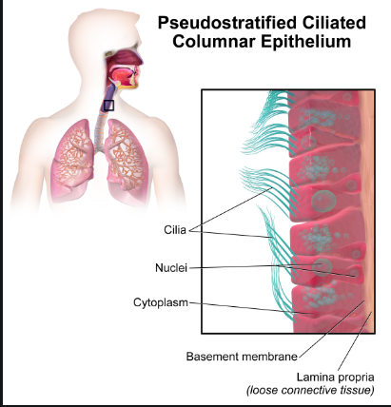
Pathogenesis
Portal of entry: respiratory tract
Site of infection: ciliated epithelial cells of respiratory tract

Slide 17
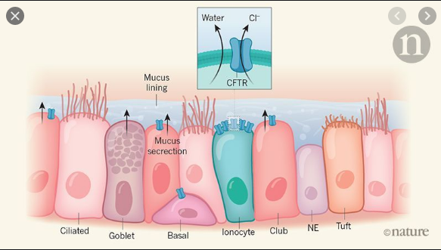
The viral neuraminidase facilitates infection by hydrolyzing the mucus film lining the respiratory tract and exposing the specific mucoprotein receptors for virus adsorption.
The death and sloughing of the ciliated epithelial cells render the respiratory tract vulnerable to secondary bacterial infection

Slide 18
Influenza
Acute respiratory disease
Vary from mild coryza to pneumonia
Characterized by abrupt onset of systemic symptoms like chills, fever, sore throat, non productive cough, head ache, myalgia
It may resolve within 7 days

Slide 19
Laboratory diagnosis
Demonstration of virus antigen
Isolation of the virus
Molecular method
Serology

Slide 20
Demonstration of virus antigen
Immunoflurescence
Smear of nasopharyngal secretion or nasal swab or centrifuged deposits of throat garling are prepared on slide and treated with fluroscent tagged antiserum

Slide 21
Isolation of the virus
Throat gargling is treated with antibiotics to destroy bacteria
The material is inoculated into amniotic cavity of 11-13 days chick embryo
Incubate the egg at 35⁰c for 3 days
The amniotic and allantoic fluid are tested for hemagglutination using guinea pig and RBC
The isolates are identified by CFT

Slide 22
Serology
CFT
Hemagglutination inhibition test: the sera are diluted serially and the influenza virus suspension is added. RBC is then added
The highest dilution in which inhibits hemagglutination is its titre.

Slide 23
Prophylaxis
Inactivated vaccines
Live attenuated vaccines
chemoprophylaxis

Slide 24
Inactivated vaccines
Influenza virus is grown in allantoic cavity and inactivated by formalin
It is purified to contain only HA & NA
This is called as subunit
It is administered parenterally in a single dose
Indication: high risk individuals
Protects for 1 year

Slide 25
Live attenuated vaccine
The virus is attenuated by repeated egg passage
It is administered intranasally or by aerosol spray

Slide 26
Chemoprophylaxis
Amantadine given orally is the drug of choice
It blocks the viral M protein
Oseltamivir: it blocks the viral neuraminidase

Slide 27
Avian influenza/ bird flu
It usually infects birds and pigs
It may affect humans who have close contact with domestic birds such as chicken
The clinical features are influenza like symptoms, pneumonia and acute respiratory distress

